Slide 1

Basics of Python
Python is an interpreted, high-level, general-purpose programming language.

Slide 2
Agenda
Considerations
Who uses python ?
Why Python ?
Version
IDEs
Syntax
Type / Arithmetic operator / Conditions
Functions
Classes
File Handling
Web Frameworks
Python Package Manager (PIP)

Slide 3
Considerations
Current tutorial is based on python 3.8.3 version on Windows 10 operating system
PyCharm community edition has been used as Integrated development environment (IDE)
User can download and install latest python from website https://www.python.org/downloads/
User can download and install latest PyCharm ide from website https://www.jetbrains.com/pycharm/

Slide 4
Who uses Python?
Some of the world-class Software Companies That use Python
Google
Facebook
Instagram
Spotify
Quora
Netflix
Dropbox

Slide 5
Why Python?
Python is an interpreted, high-level, general-purpose programming language.
Python is a multi-paradigm programming language. Object-oriented programming and structured programming are fully supported, and many of its features support functional programming and aspect-oriented programming
Python is meant to be an easily readable language. Its formatting is visually uncluttered, and it often uses English keywords where other languages use punctuation
Python uses whitespace indentation, rather than curly brackets or keywords, to delimit blocks
Aim to help programmers write clear, logical code for small and large-scale projects

Slide 6
Version
Python 1.0 released in 1994
Python 2.0 released in 2000
Python 3.0 released in 2008
Stable version 3.8.3
Preview release 3.9.0b3 in June 2020

Slide 7
IDEs (Integrated Development Environment)
Best freeware IDEs
IDLE (By default comes with Python installer)
PyCharm Community Edition (Best in freeware category)
Spyder
Atom
Jupyter
PyDev (third-party Python editor for Eclipse)

Slide 8

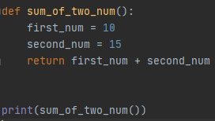
Syntax
Correct Indentation:

Slide 9
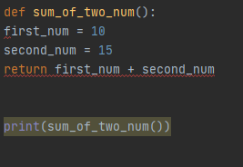
Syntax
Incorrect Indentation:

Slide 10
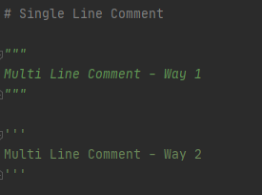
Syntax
How to comment code

Slide 11
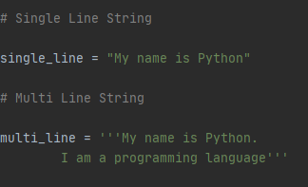
Type
Strings

Slide 12
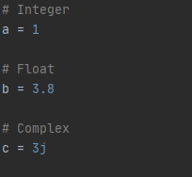
Type
Numbers

Slide 13
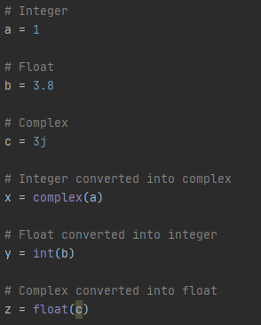
Type
Conversions

Slide 14
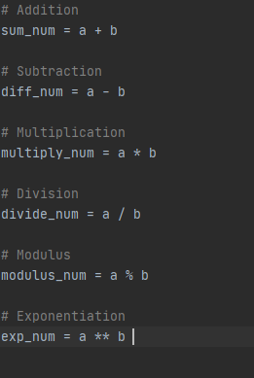
Arithmetic operator

Slide 15
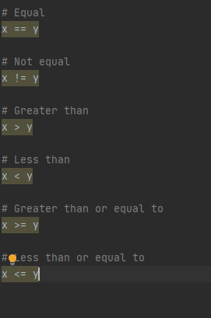
Comparison Operators

Slide 16
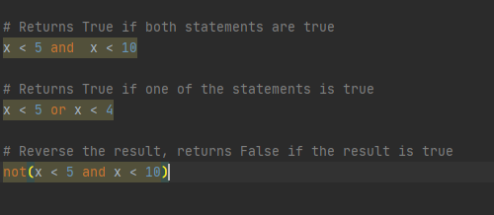
Logical Operators

Slide 17
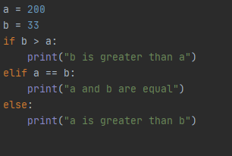
Conditions
If – elif - else

Slide 18
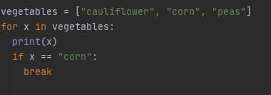
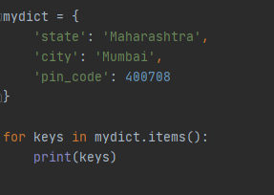
Loop
For Loop

Slide 19
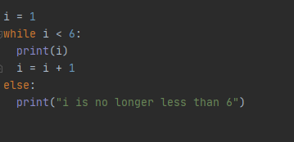
Loop
While loop

Slide 20
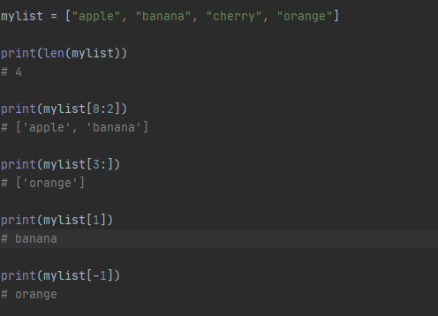
List
A list is a collection which is ordered and changeable. In Python lists are written with square brackets.

Slide 21
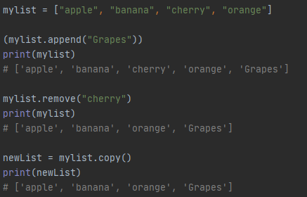
List - Functions

Slide 22
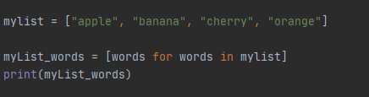
List Comprehension

Slide 23
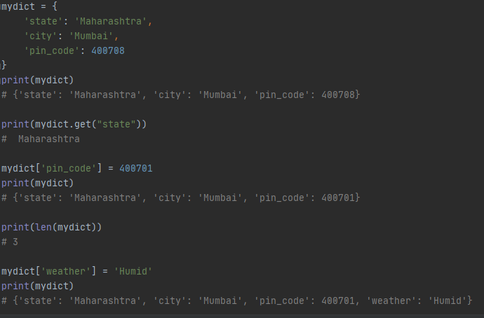
Dictionary
A dictionary is a collection which is unordered, changeable and indexed. In Python dictionaries are written with curly brackets, and they have keys and values

Slide 24
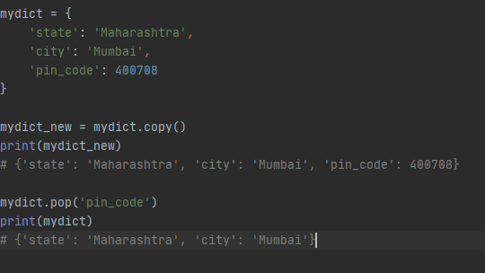
Dictionary

Slide 25
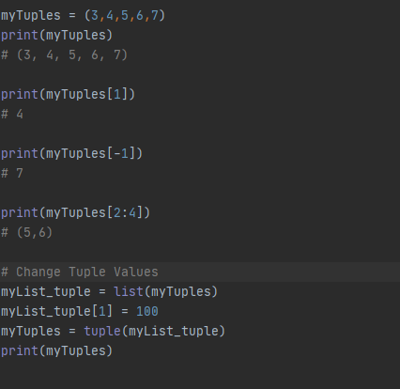
Tuple
A tuple is a collection which is ordered and unchangeable. In Python tuples are written with round brackets.

Slide 26
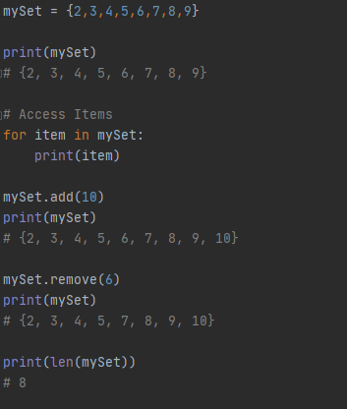
Set
A set is a collection which is unordered and unindexed. In Python sets are written with curly brackets.

Slide 27
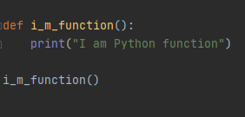
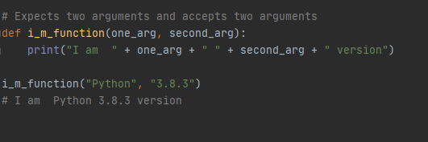
Functions

Slide 28
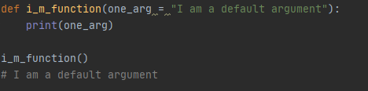
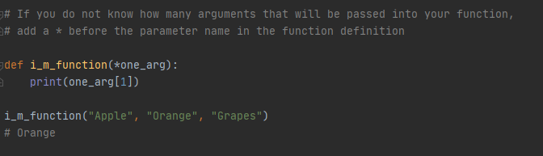
Functions

Slide 29
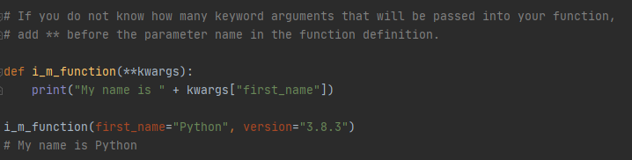
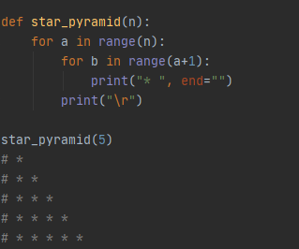
Functions

Slide 30
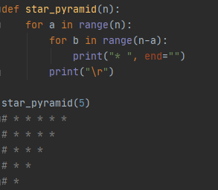
Functions

Slide 31
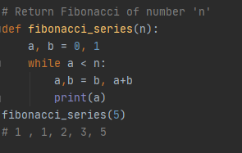
Function

Slide 32
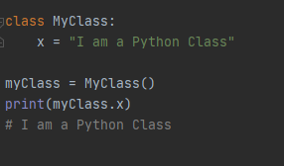
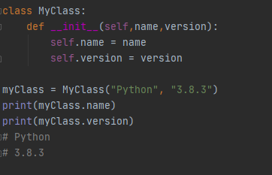
Class

Slide 33
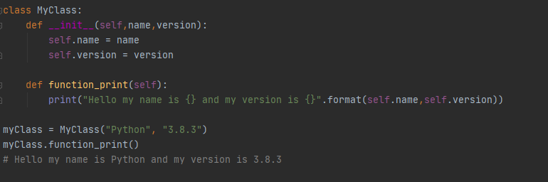
Class

Slide 34
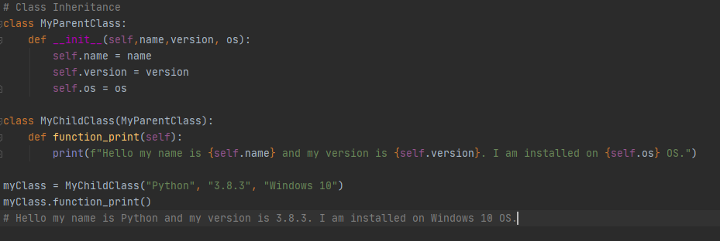
Class

Slide 35
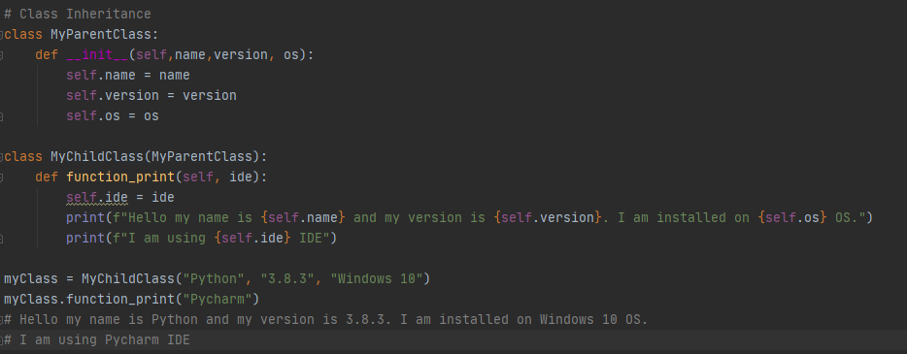
Class

Slide 36
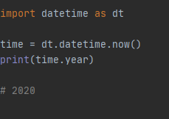
Import

Slide 37
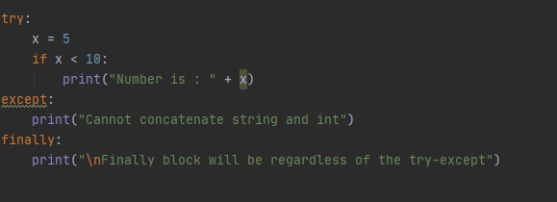
Try - Except - Finally
The try block lets you test a block of code for errors.
The except block lets you handle the error.
The finally block lets you execute code, regardless of the result of the try- and except blocks.

Slide 38
File Handling
The open() function takes two parameters; filename, and mode.
"r" - Read - Default value. Opens a file for reading, error if the file does not exist
"a" - Append - Opens a file for appending, creates the file if it does not exist
"w" - Write - Opens a file for writing, creates the file if it does not exist
"x" - Create - Creates the specified file, returns an error if the file exists

Slide 39
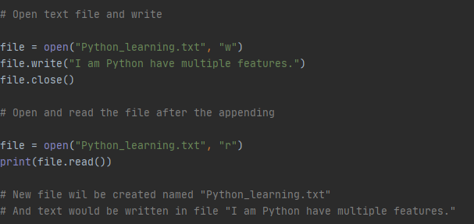
File Handling

Slide 40
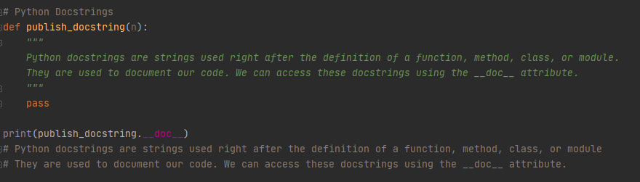
Docstring

Slide 41
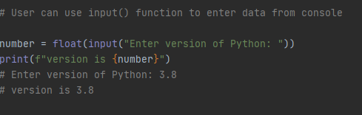
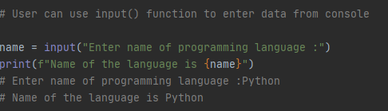
Input

Slide 42
Web Frameworks for Web Development
Django
Flask
Pylon
CherryPy
Web2py
TurboGears

Slide 43
Python Package Manager (PIP)
A package contains all the files you need for a module.
Some of the examples:
pip install django
pip install behave
pip install selenium

Slide 44
Resources
https://www.python.org/

Slide 45
Thank You!
For any queries connect me at jatinkochhar@hotmail.com

